Slide 1

An Analysis Of Crime In India
Submitted by :- Ayush Gajbhiye
To :- Prof. Irfan Shaikh

Slide 2
Introduction
The dataset provides a comprehensive record of crimes reported under the Indian Penal Code (IPC) across various districts of India from 2001 to 2012.
It encompasses a wide range of crime categories, including but not limited to murder, robbery, theft, rape, and more.
The dataset offers valuable insights into the dynamics of criminal activities within the socio-cultural and geographical landscape of India.

Slide 3
Objective
In this presentation, we will delve deeper into the landscape of crime in India, exploring key trends, challenges, and responses. Through data analysis, case studies, and expert insights, we aim to provide a comprehensive understanding of crime in India and discuss strategies for building safer and more resilient communities.

Slide 4
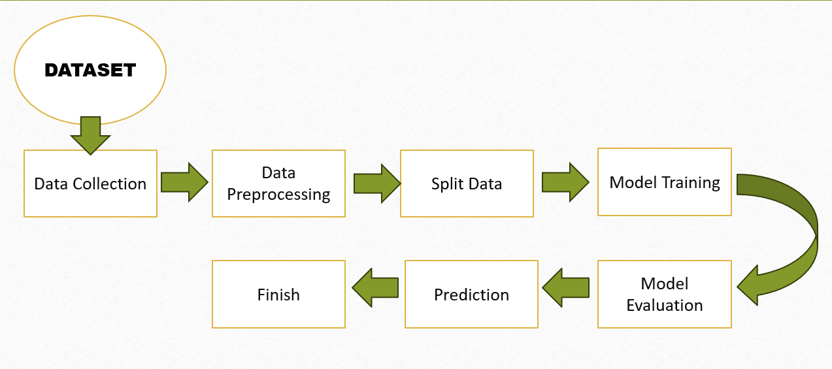
Process Flow

Slide 5



Tools and Platforms used for Model Building
Tools : Python
Platform : Jupyter Notebook
Library Used : Scikit-learn, Matplotlib

Slide 6
Challenges
Ensuring the dataset is accurate, complete, and reliable is essential. Missing data, errors, or inconsistencies could affect the validity of the analysis.
Outliers in the data can disproportionately influence the model's coefficients and predictions.
If the dataset includes time-series data, the temporal dynamics of the phenomena being modeled can affect the interpretation of RMSE. Changes in trends, seasonality, or other temporal patterns may influence the RMSE values over time.

Slide 7
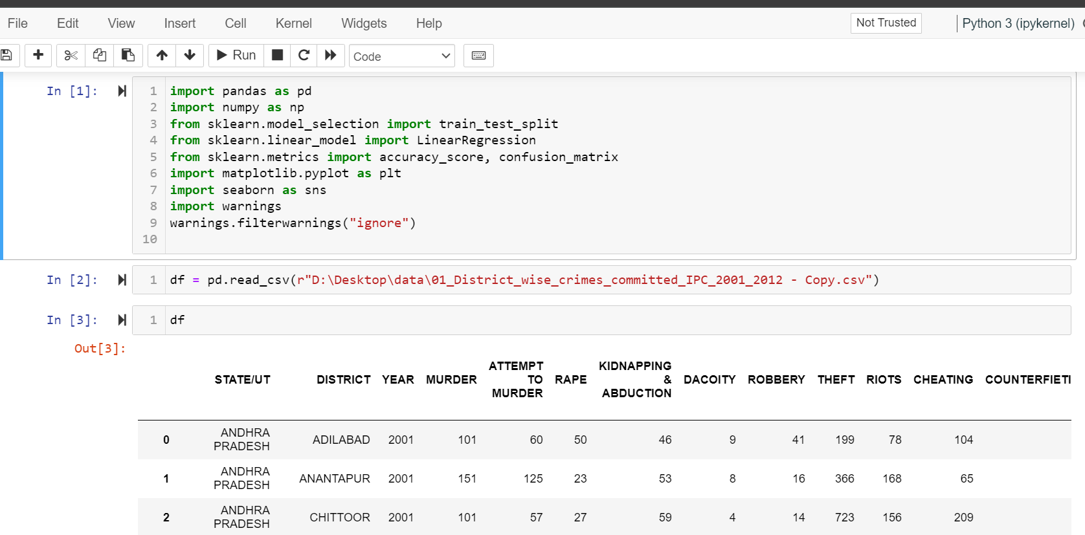
Exploratory Data Analysis (EDA)
Data importing

Slide 8
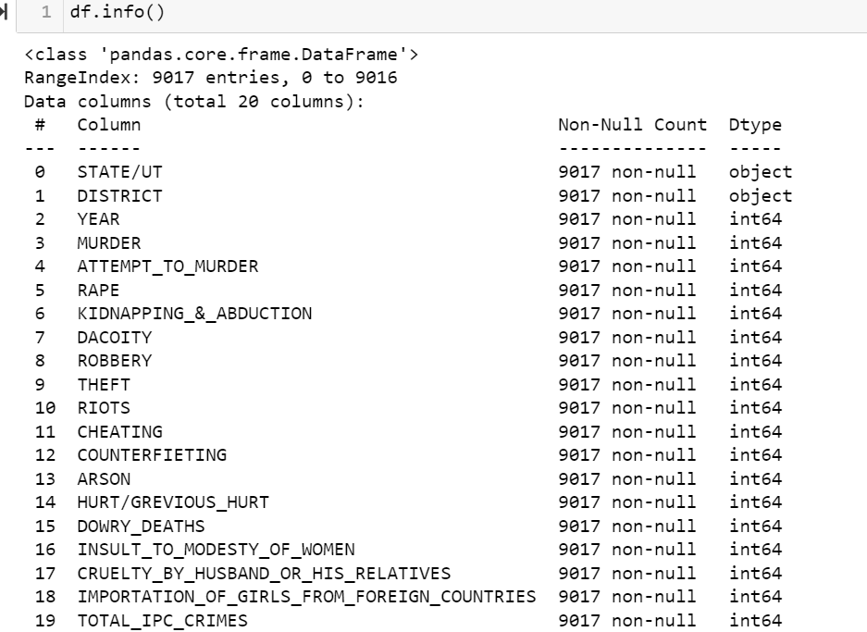
Number of rows and columns
There are 9017 rows and 20 columns

Slide 9
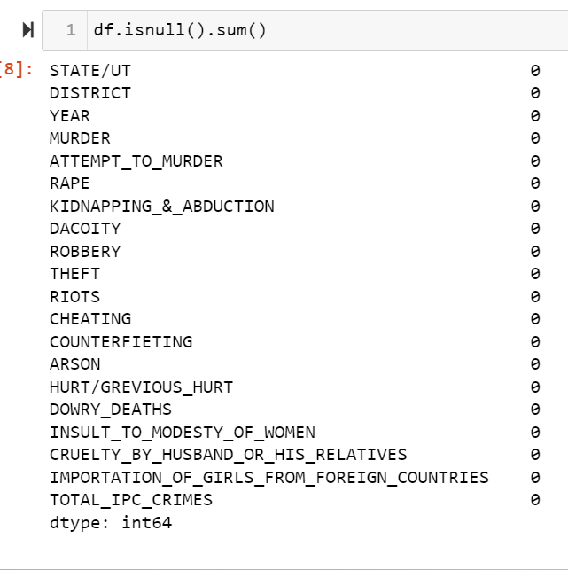
Missing values
There are no missing values present in dataset

Slide 10
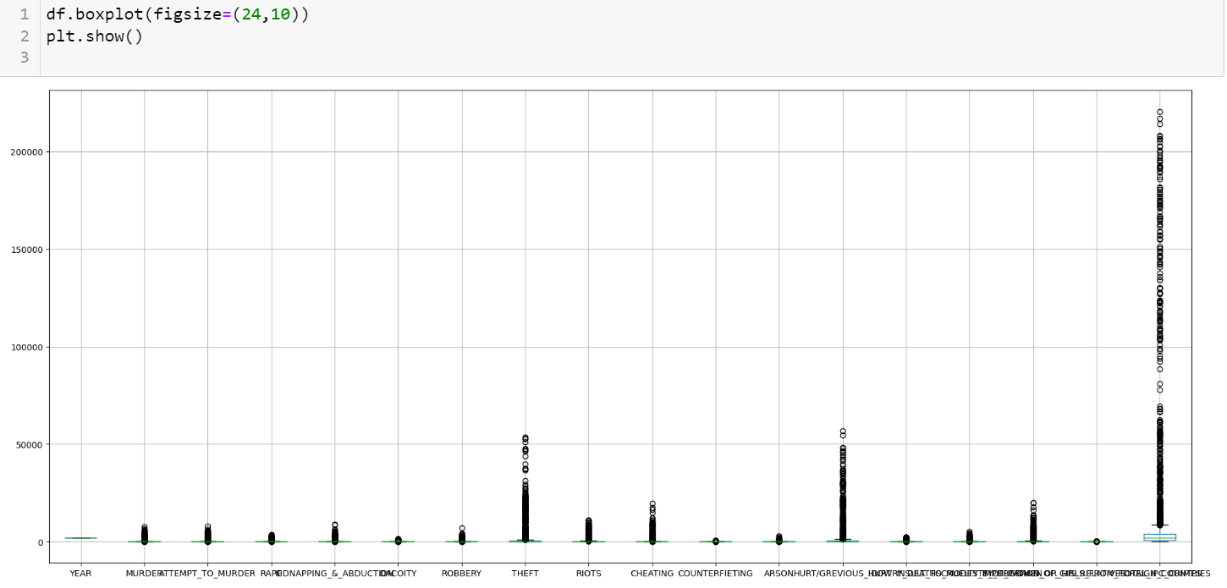
Outlier
Outlier present in the data

Slide 11
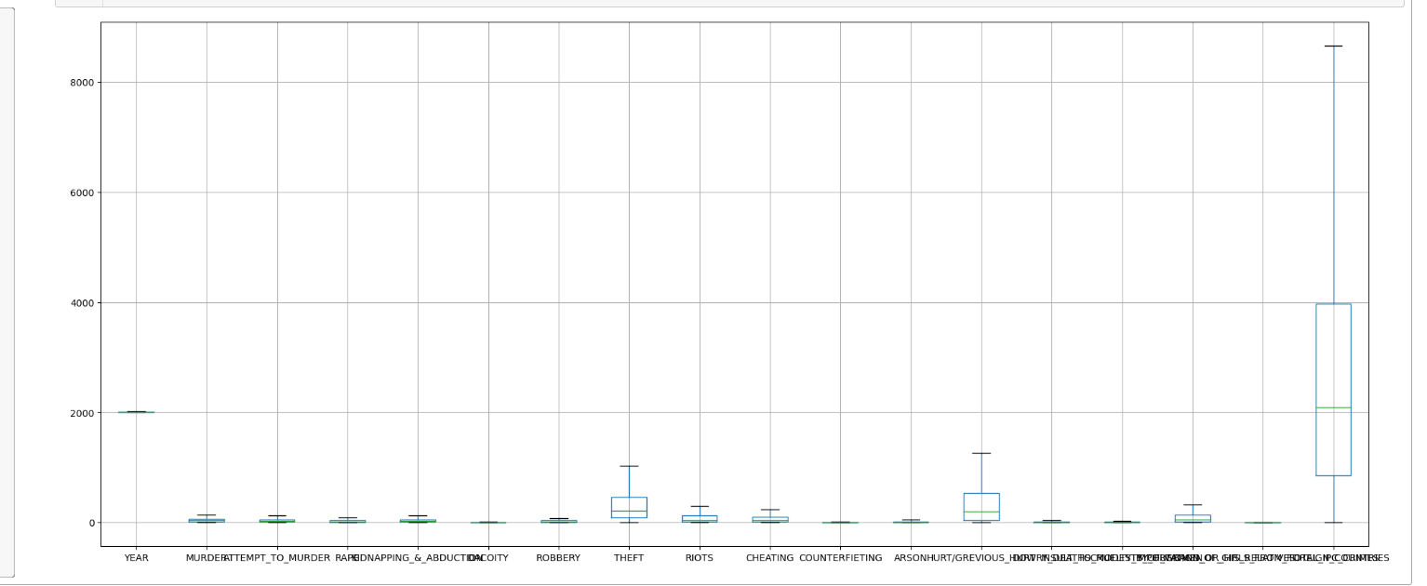
Treatment of Outlier
Outlier is removed

Slide 12
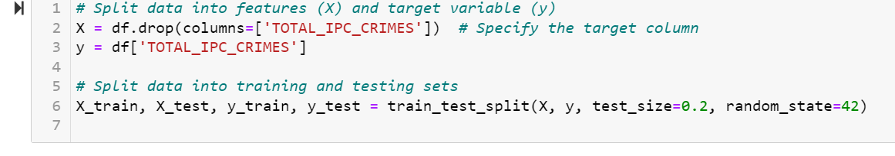
Data Partition for building models
Data partitioning is used to split the original data set into subsets for training and testing.
70% of data is taken for training and remaining 30% is taken for testing.
Subset of data is further divided into X_train, Y_train, X_test, Y_test.0%

Slide 13
Models Used for Prediction
Decision Tree
Random Forest

Slide 14
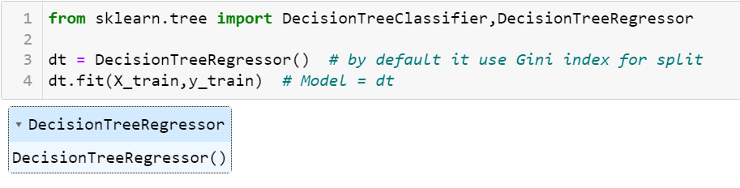
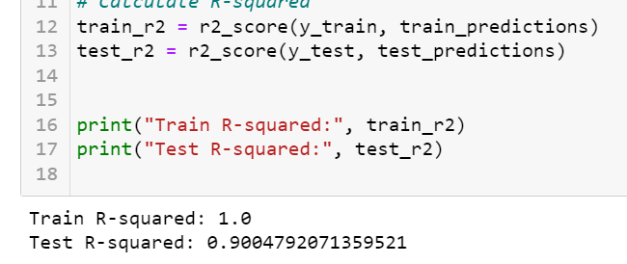
Decision Tree
Model building
model report before pruning

Slide 15
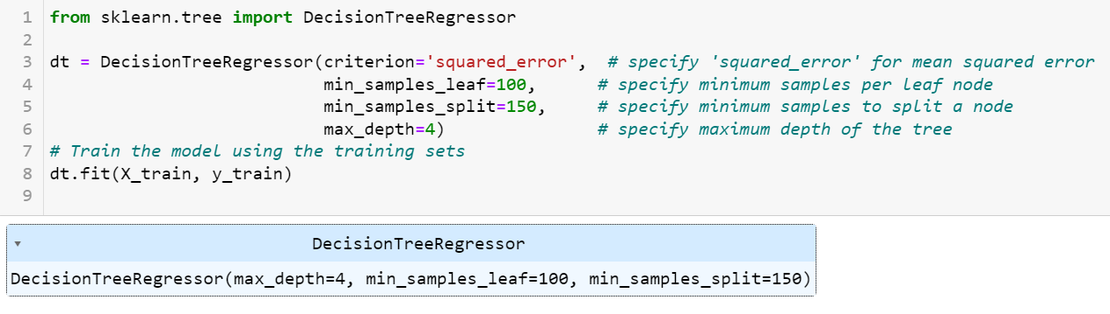
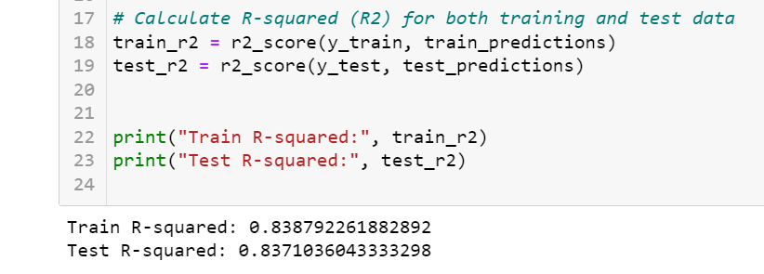
Model Improvement after Pruning
Model report after pruning
Accuracy of model on train 83%, so we say that the model is good fit
Accuracy of model on test 83%, so we say that the model is good fit

Slide 16
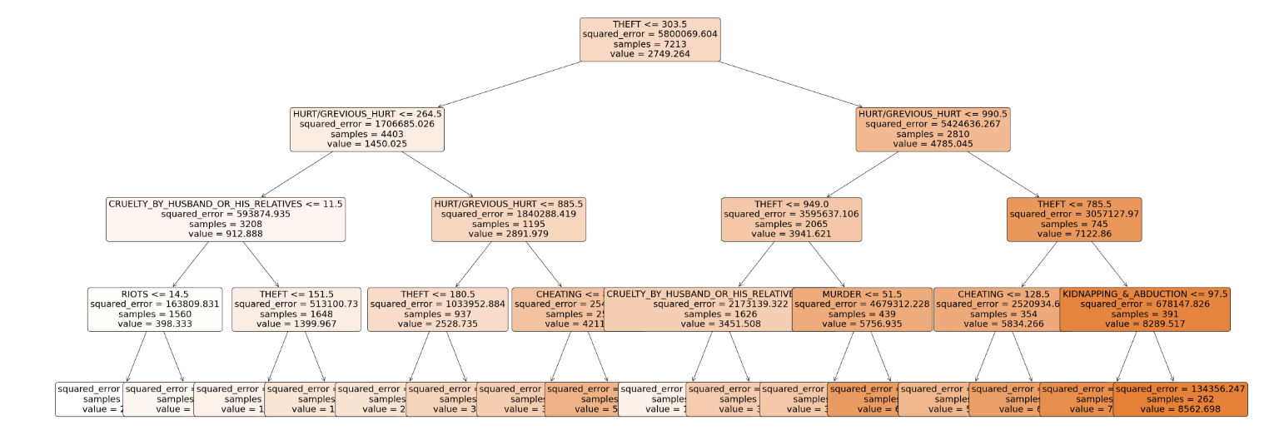
Plotting Decision Tree

Slide 17
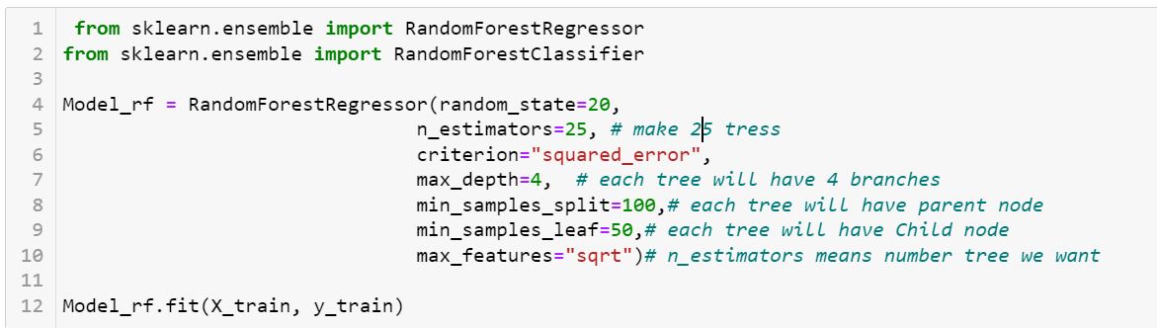
Random Forest
Model

Slide 18
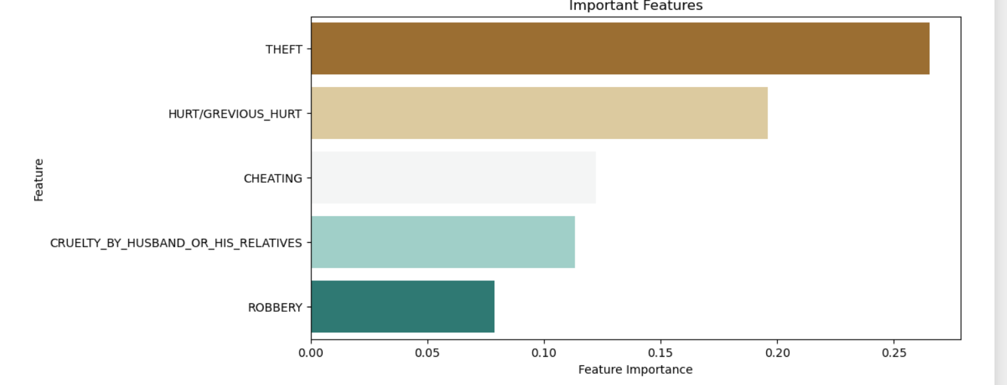
Importance Features

Slide 19
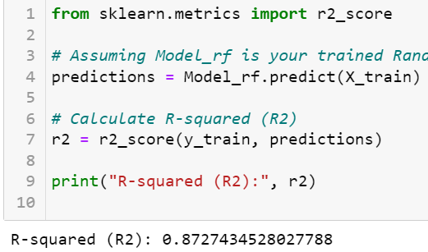
Classification report
Train data
Accuracy of model on train 87%, so we say that the model is good fit

Slide 20
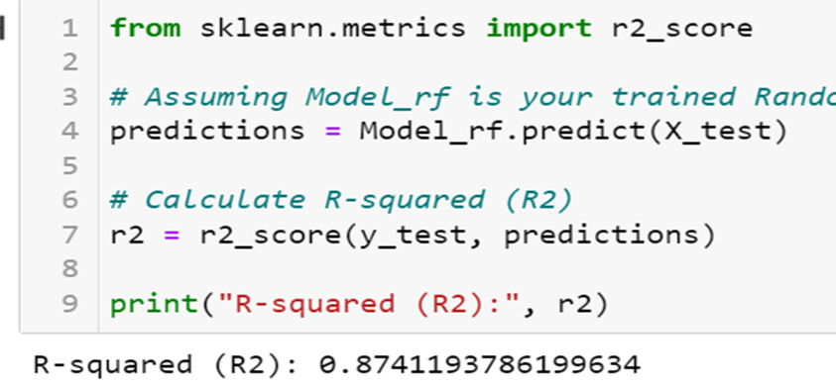
.
Test data
Accuracy of model on test 87%, so we say that the model is good fit

Slide 21
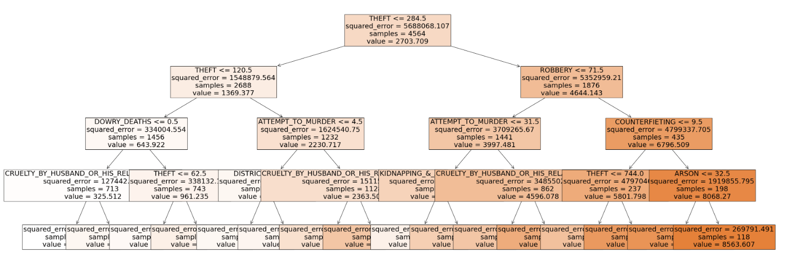
Plotting Random Forest

Slide 22
Comparative Analysis
Decision Tree
In decision tree the accuracy in Train data is 83%(0.838792261882892)
Root mean squared error on train data is = 4.53
And in Test data the accuracy is 83%(0.8371036043333298)
Root mean squared error on test data is = 2.91
Random Forest
In random forest the accuracy in Train data is 87%(0.87274352802778)
Root mean squared error on train data is = 1.40
And in Test data the accuracy is 87%(0.87411978619934)
Root mean squared error on test data is = 3.00

Slide 23
Conclusion
Both decision tree and random forest models are doing a good job at correctly classifying data. They're accurate around 83% to 87% of the time, which is pretty good. Therefore the conclusion drawn decision tree achieved an accuracy of 83%, while the random forest achieved a higher accuracy of 87%
Hence random forest model best fits the data.

Slide 24
“THANK YOU”

